Slide 1


Slide 2
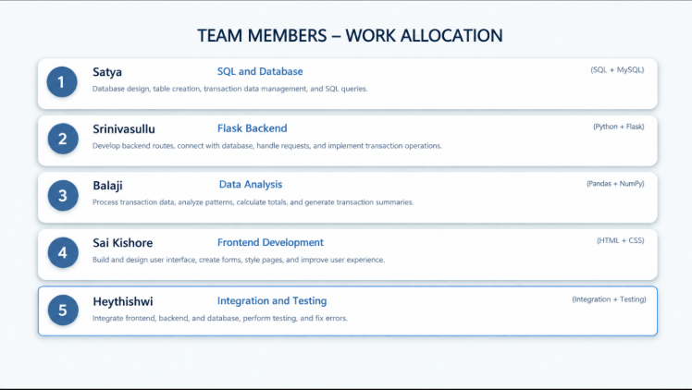
TEAM -07

Slide 3
SQL &Database - Satya
Technologies Used
SQL and relational database concepts
Work Allocation
Designs tables for customer, account, and transaction records.
Writes queries to insert, retrieve, update, and filter transaction data.
Maintains consistency and supports reliable data storage.
Outcome
Banking records are organized and can be retrieved accurately

Slide 4
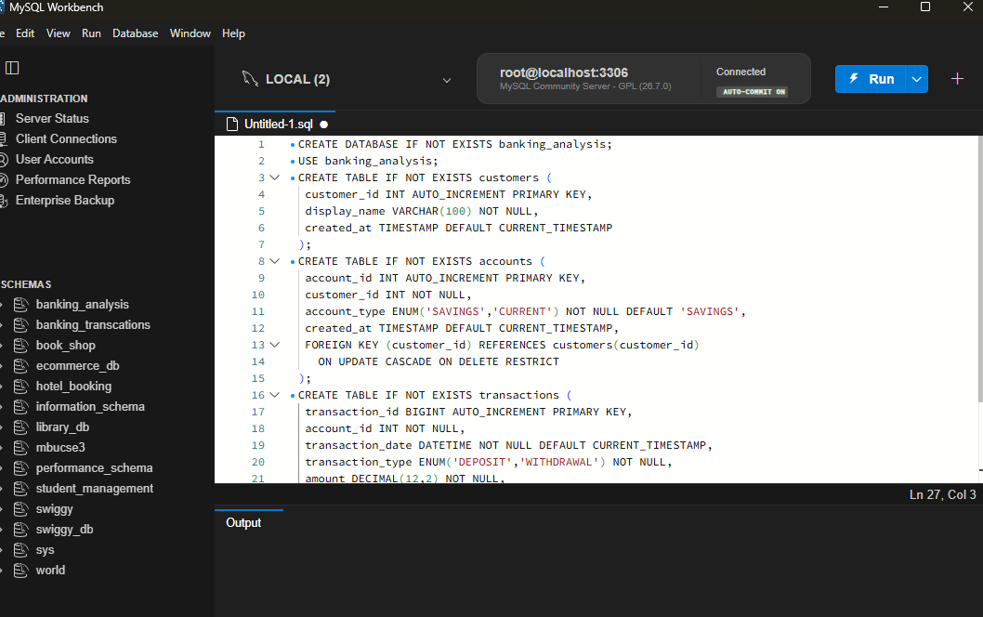

Slide 5
Flask backend - Srinivasulu
Technologies Used
Python and Flask
Work Allocation
Creates backend routes for banking operations.
Connects the application interface to the database.
Handles requests and returns appropriate responses.
Adds input validation and error handling.
Outcome
Frontend actions communicate with database operations through the backend

Slide 6
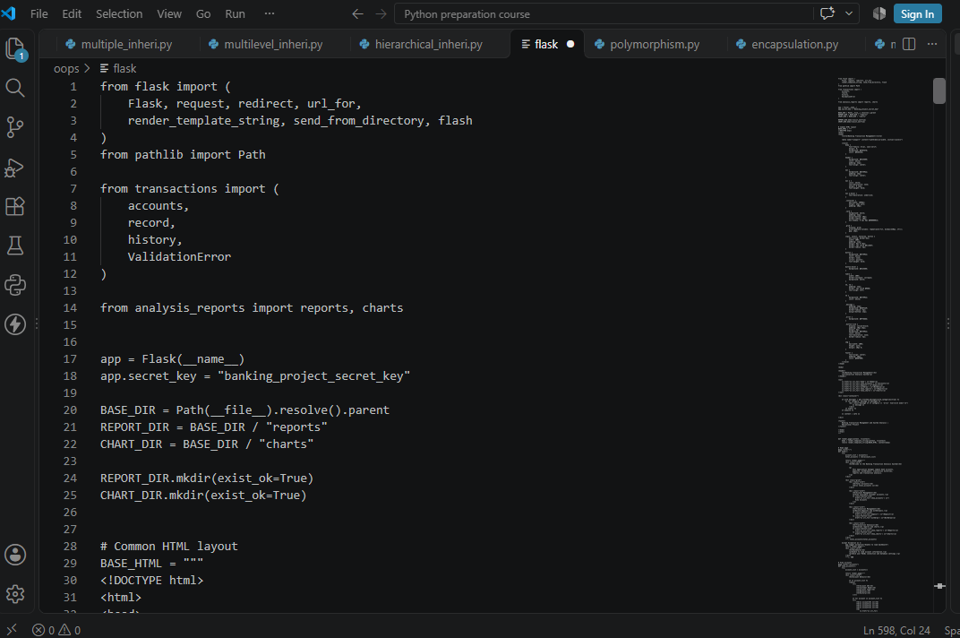

Slide 7
Data Analysis - Balaji
Technologies Used
Python, Pandas, NumPy
Work Allocation
Loads and cleans transaction data for analysis.
Uses Pandas to filter, group, and summarize transactions.
Uses NumPy for numerical calculations and summaries.
Identifies patterns such as transaction totals and category-wise activity.
Outcome
Transaction data is converted into useful summaries and insights

Slide 8
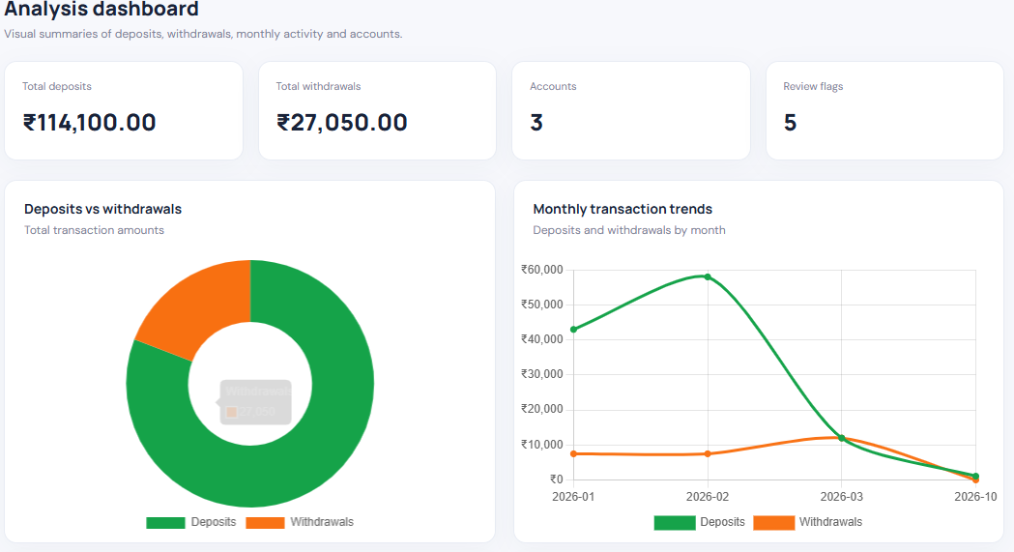
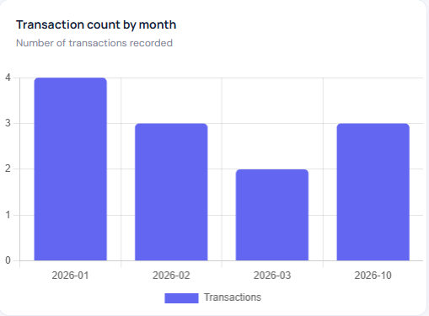
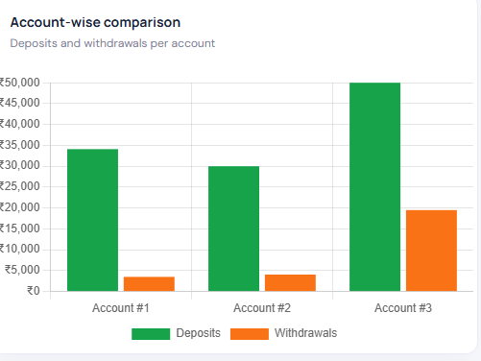

Slide 9
Frontend Development – Sai Kishore
Technologies Used:
HTML
CSS
Work Done:
Builds the pages and user interface for the banking system.
Styles forms, navigation, tables, and transaction views.
Keeps the layout clear and easy to use.
Outcome:
A simple interface through which users can access banking features and view transaction information.

Slide 10
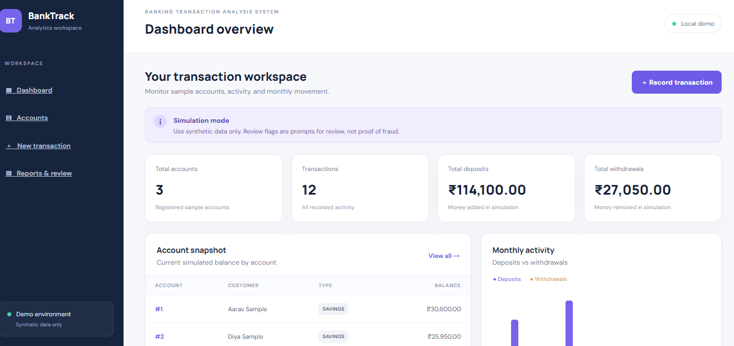
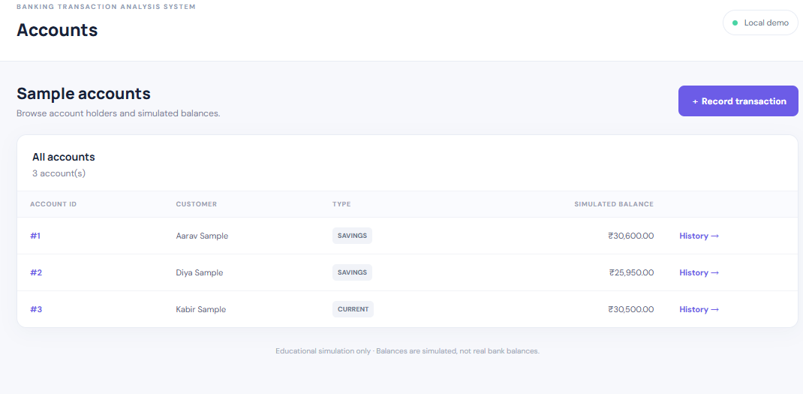
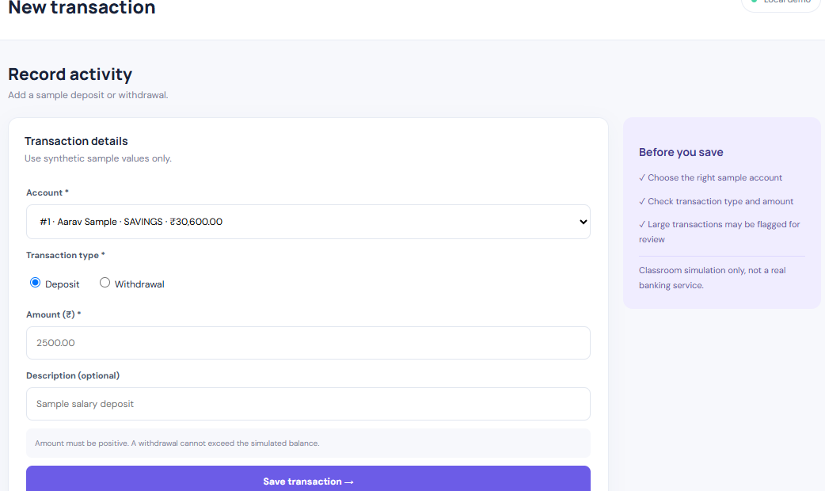

Slide 11
Integration &Testing - Heythishwi
Technologies Used
Frontend, Flask backend, SQL database, Pandas and NumPy components
Work Allocation
Connects the frontend, backend, database, and analysis modules.
Tests key workflows such as viewing and recording transactions.
Checks input validation, data flow, and error responses.
Reports issues and verifies fixes across the system.
Outcome
The combined system works as expected and produces reliable transaction results.

Slide 12
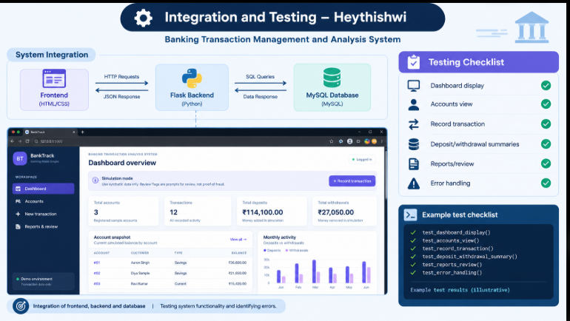

Slide 13


